Slide 1
Lesson 3.2
The Legal Framework
CGPRT(W) : Ensuring Clean Seas and Coasts in Western Region ……

Slide 2
Objective
To understand the key international conventions that apply to oil spill response.
To understand the relevant regional frameworks and regional capacity-building projects/initiatives that exist around the world.
CGPRT(W) : Ensuring Clean Seas and Coasts in Western Region ……

Slide 3
Introduction
This lesson will cover:
An introduction to the work of IMO
The principal International Conventions
  MARPOL, OPRC and Salvage
An introduction to Liability and Compensation
CGPRT(W) : Ensuring Clean Seas and Coasts in Western Region ……

Slide 4
IMO
UN specialized agency responsible for safety and security of shipping and prevention of marine pollution by ships
Established in 1948
Participants¹
  174 Member States
  3 Associate Members
  81 Non-governmental organizations (NGOs)
  64 Inter-governmental organizations (IGOs)
  Note 1: as at October 2018 – Source: www.imo.org
CGPRT(W) : Ensuring Clean Seas and Coasts in Western Region ……

Slide 5
IMO
  “The mission of the International Maritime Organization (IMO) as a United Nations specialized agency it to promote safe, secure, environmentally sound, efficient and sustainable shipping through cooperation.”
CGPRT(W) : Ensuring Clean Seas and Coasts in Western Region ……

Slide 6
IMO
  “This will be accomplished by adopting the highest practicable standards of maritime safety and security, efficiency of navigation and prevention and control of pollution from ships, as well as through consideration of the related legal matters and effective implementation of IMO’s instruments with a view to their universal and uniform application.”
CGPRT(W) : Ensuring Clean Seas and Coasts in Western Region ……

Slide 7
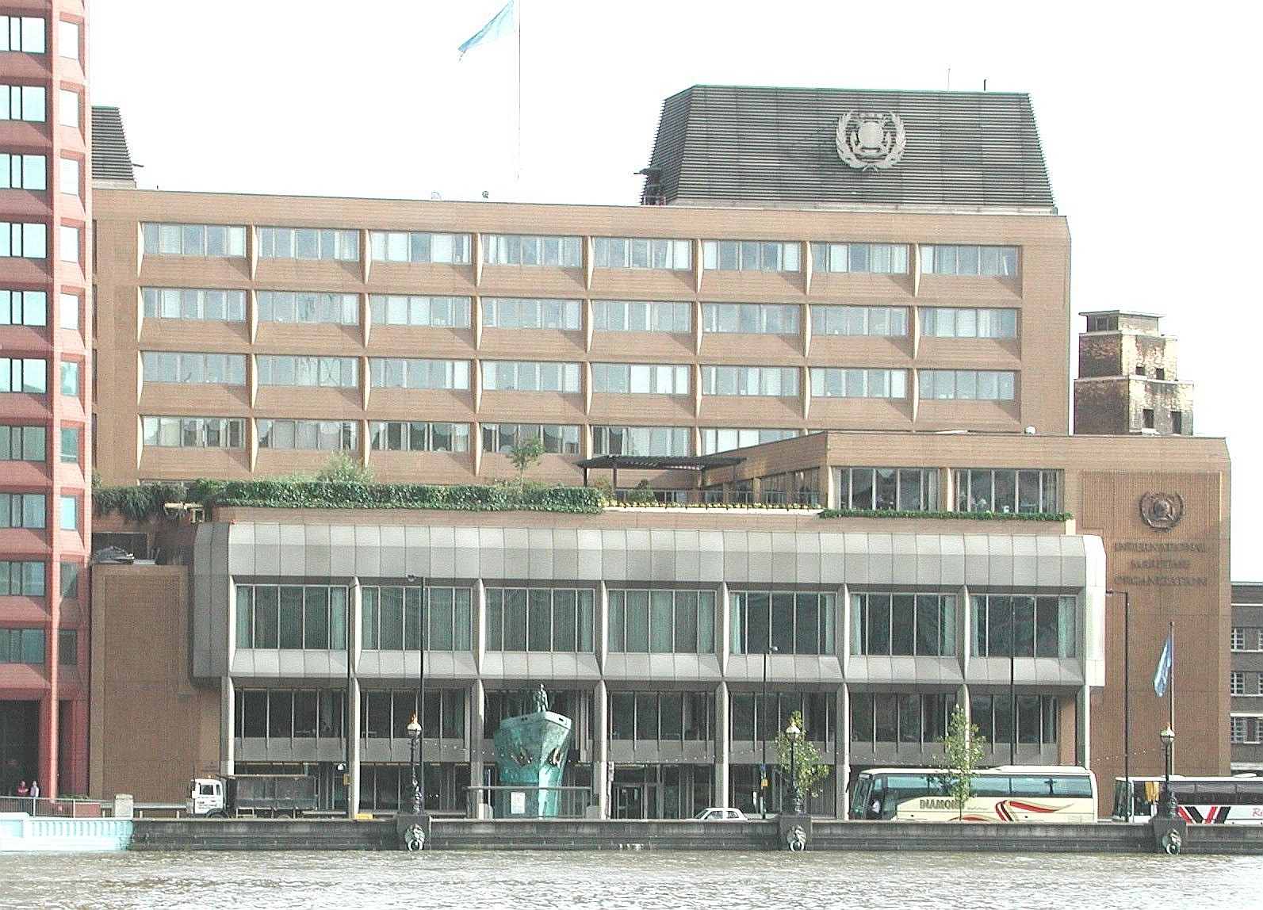
IMO HQ – London
CGPRT(W) : Ensuring Clean Seas and Coasts in Western Region ……

Slide 8
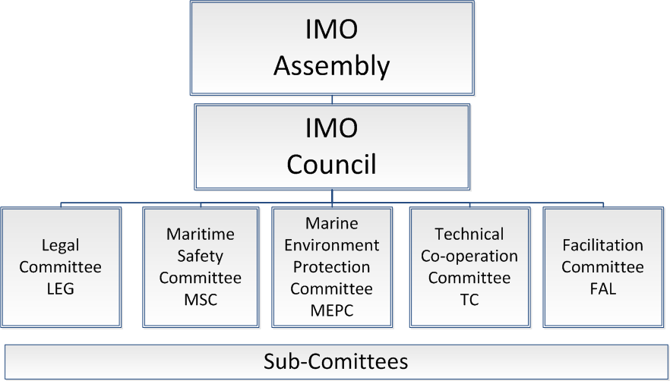
IMO Organization
CGPRT(W) : Ensuring Clean Seas and Coasts in Western Region ……

Slide 9
Timeline of Key Events
TITANIC
1912
SOLAS
1914
SOLAS
1929
IMCO
1948
OILPOL
1954
IMCO
1959
TORREY CANYON 1967
MARPOL
1978
SOLAS
1974
CLC
1969
MARPOL
1973
IMO
1982
OPRC
1990
FUND
1992
MARPOL
1997
OPRC-HNS
2000
EXXON VALDEZ
1989
SOLAS
1948
HNS
1996
HNS
2010
CGPRT(W) : Ensuring Clean Seas and Coasts in Western Region ……

Slide 10
Key Conventions
The United Nations Convention on the Law of the Sea (UNCLOS)
Establishes rules governing all uses of the oceans and their resources.
Safety of Life at Sea (SOLAS)
Specifies minimum standards for the construction, equipment and operation of ships, compatible with their safety.
CGPRT(W) : Ensuring Clean Seas and Coasts in Western Region ……

Slide 11
Key Conventions
International Convention for the Prevention of Pollution from Ships, 1973/78 (MARPOL)
to prevent pollution of the marine environment by ships from operational or accidental causes.
International Convention on Oil Pollution Preparedness, Response and Cooperation, 1990 (OPRC)
to establish measures to combat major incidents or threat of marine pollution.
CGPRT(W) : Ensuring Clean Seas and Coasts in Western Region ……

Slide 12
MARPOL
Annex | Description
I | Regulations for the Prevention of Pollution by Oil
II | Regulations for the Control of Pollution by Noxious Liquid Substances in Bulk
III | Prevention of Pollution by Harmful Substances Carried by Sea in Packaged Form
IV | Prevention of Pollution by Sewage from Ships
V | Prevention of Pollution by Garbage from Ships
VI | Prevention of Air Pollution from Ships
CGPRT(W) : Ensuring Clean Seas and Coasts in Western Region ……

Slide 13
OPRC Convention
  Global framework for international cooperation in combating major incidents or threat of marine pollution
  Parties to establish measures to deal with pollution incidents either nationally or in cooperation with other countries
  Entered into force on 13 May 1995
CGPRT(W) : Ensuring Clean Seas and Coasts in Western Region ……

Slide 14
OPRC Convention
    These measures are to include:
    Oil pollution emergency plans
    Reporting procedures and actions
    In cooperation with the oil and shipping industries, port authorities and any other relevant entities, establish:
      Response equipment
      Exercises
      Training
      Communications
      Response
CGPRT(W) : Ensuring Clean Seas and Coasts in Western Region ……

Slide 15
Key Conventions
International Convention Relating to Intervention on the High Seas in Cases of Oil Pollution Casualties, 1969 (INTERVENTION)
Affirms the rights of coastal states to take such measures as may be necessary to prevent, mitigate or eliminate danger to its coastline or related interests following a marine casualty.
CGPRT(W) : Ensuring Clean Seas and Coasts in Western Region ……

Slide 16
Intervention Convention
Extends State jurisdiction to high seas without affecting principle of freedom of high seas.
Empowers a Contracting Party to take such measures as may be necessary to prevent a pollution threat to its coastline or related interests.
CGPRT(W) : Ensuring Clean Seas and Coasts in Western Region ……

Slide 17
Intervention Convention
“Measures” are not defined and give State extensive flexibility to take whatever measures it deems appropriate in the circumstances.
“Related interests” are broadly defined and include:
  port and fishing activities; tourist attractions;
  health of the coastal population; and
  conservation of living resources and wildlife.
CGPRT(W) : Ensuring Clean Seas and Coasts in Western Region ……

Slide 18
Key Conventions
International Convention on Salvage, 1989 (SALVAGE)
  Expands the original “no cure, no pay” principle to provide an enhanced salvage award for preventing or minimizing damage to the environment.
CGPRT(W) : Ensuring Clean Seas and Coasts in Western Region ……

Slide 19
Key Conventions
International Convention on Civil Liability for Oil Pollution Damage (CLC)
Ensures that adequate compensation is available to persons who suffer oil pollution damage resulting from maritime casualties involving tankers carrying persistent oil cargo;
Places liability for such damage on the owner of the ship from which the polluting oil escaped or was discharged.
CGPRT(W) : Ensuring Clean Seas and Coasts in Western Region ……

Slide 20
Key Conventions
International Convention on the Establishment of an International Fund for Compensation for Oil Pollution Damage (FUND)
Establishes an international fund, subscribed to by cargo interests, which provides compensation to the extent that the CLC is inadequate.
CGPRT(W) : Ensuring Clean Seas and Coasts in Western Region ……

Slide 21
Key Conventions
International Convention on Civil Liability for Bunker Oil Pollution Damage (BUNKER) 2001
Ensures that adequate compensation is available to persons who suffer oil pollution damage resulting from bunker oil spilled from a wide range of ships;
Places liability for such damage on the owner of the ship from which the polluting oil escaped or was discharged.
CGPRT(W) : Ensuring Clean Seas and Coasts in Western Region ……

Slide 22
National Laws
International conventions need to be implemented in domestic legislation.
However, domestic legislation may impose further (and more stringent) requirements.
CGPRT(W) : Ensuring Clean Seas and Coasts in Western Region ……

Slide 23
IMO-Supported Institutes
World Maritime University (WMU) – Sweden
International Maritime Law Institute (IMLI) – Malta
REMPEITC – Carib – Regional Marine Pollution Emergency, Information and Training Centre for the wider Caribbean Region
REMPEC – Regional Marine Pollution Emergency Response Centre for the Mediterranean Sea
CGPRT(W) : Ensuring Clean Seas and Coasts in Western Region ……

Slide 24
Regional Agreements
There are a number of regional government-to-government agreements including bilateral and multilateral.
These agreements assist in both preparedness and response to oil spill incidents within their respective areas.
They provide a forum for States to exchange concepts, research and information.
They allow for regional agreements on cooperation and response to be developed.
CGPRT(W) : Ensuring Clean Seas and Coasts in Western Region ……

Slide 25


UNEP Regional Seas Programmes
Regional Seas Programme launched in 1974
Aims to address the accelerating degradation of the world’s oceans and coastal areas
Created 13 Regional Seas programmes for environmental management to be coordinated and implemented by countries sharing a common body of water
CGPRT(W) : Ensuring Clean Seas and Coasts in Western Region ……

Slide 26
UNEP Regional Seas Programmes
143 countries participate
5 partner programmes cover the Antarctic, Arctic, Baltic Sea, Caspian Sea and NE Atlantic
Provides regional forums to tackle marine environmental issues including pollution preparedness and capacity building
CGPRT(W) : Ensuring Clean Seas and Coasts in Western Region ……

Slide 27
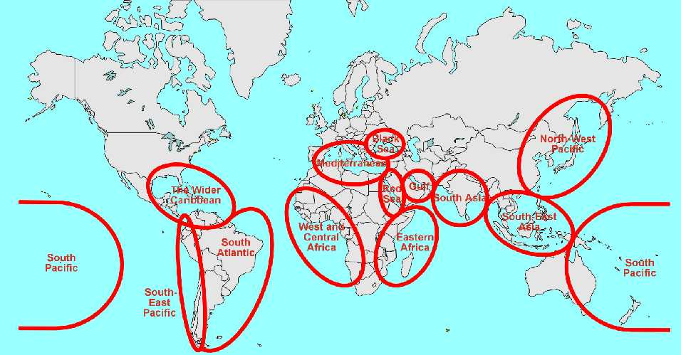
UNEP Regional Seas Areas
CGPRT(W) : Ensuring Clean Seas and Coasts in Western Region ……

Slide 28
Regional Agreements
There are a number of regional agreements in place worldwide.
One example is the Bonn Agreement which provides a multilateral agreement to countries bordering the North Sea and Western Approaches.
Within this regional agreement there are a number of specific SAR and Counter Pollution bilateral agreements.
CGPRT(W) : Ensuring Clean Seas and Coasts in Western Region ……

Slide 29
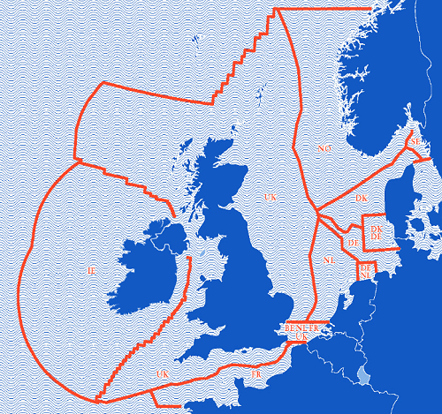
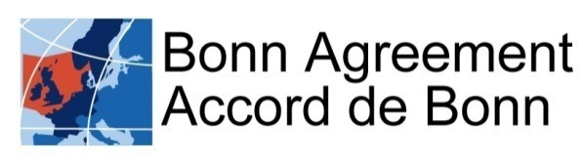
Regional Agreements
Established 1969
Amended
1983, 1987 and 2001
CGPRT(W) : Ensuring Clean Seas and Coasts in Western Region ……

Slide 30
Global Initiative Programme
Launched jointly by IMO and the oil industry in 1996
Jointly led by IMO and IPIECA (the global oil and gas industry association for environmental and social issues)
Supported by industry, industry-funded Tier 3 oil spill centres and participation from International Tanker Owners Pollution Federation Limited (ITOPF)
CGPRT(W) : Ensuring Clean Seas and Coasts in Western Region ……

Slide 31
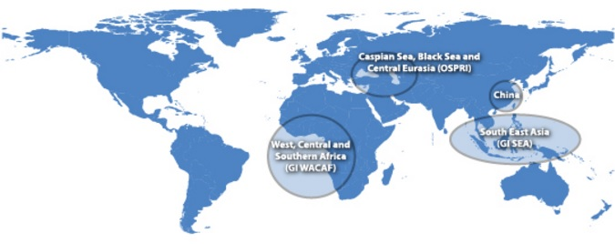
Global Initiative Programme
CGPRT(W) : Ensuring Clean Seas and Coasts in Western Region ……

Slide 32
Global Initiative Programme
GI activities are currently focused on:
Caspian, Black Sea and Central Eurasia – OSPRI
West and Central Africa – GI WACAF
South East Asia – GI SEA
China
CGPRT(W) : Ensuring Clean Seas and Coasts in Western Region ……

Slide 33
Summary
We have considered the key international conventions that apply to oil spill response.
We have looked at the relevant regional frameworks and regional capacity-building projects/initiatives that exist around the world.
CGPRT(W) : Ensuring Clean Seas and Coasts in Western Region ……

Slide 34
Any questions?
CGPRT(W) : Ensuring Clean Seas and Coasts in Western Region ……

